Slide 1
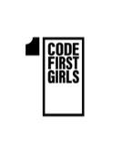

COOKING MAMA

Slide 2
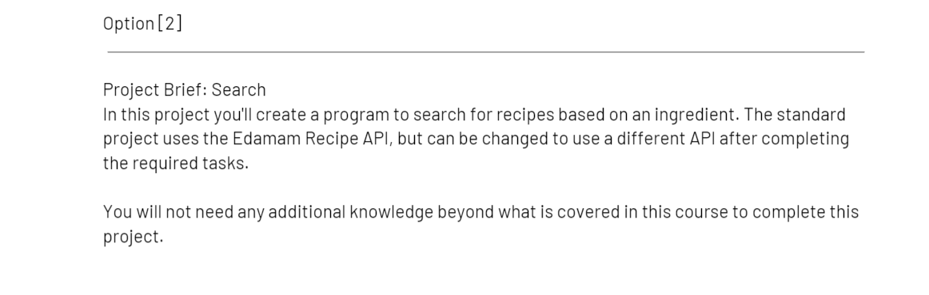
Task

Slide 3
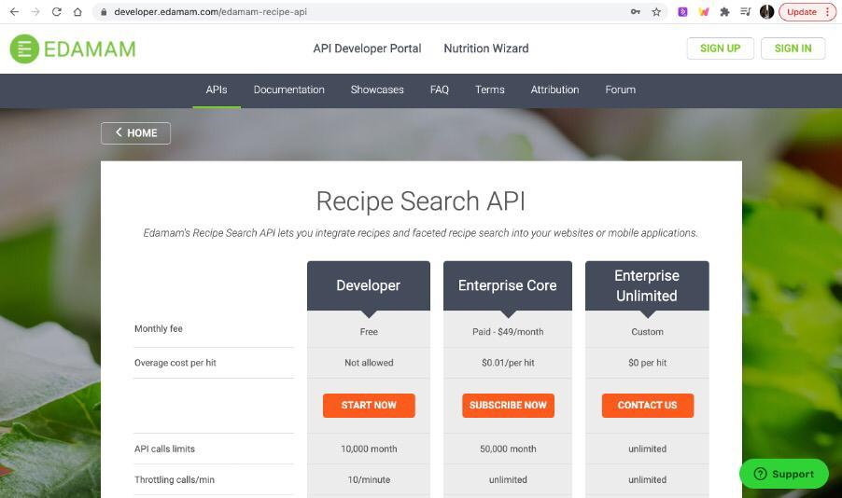
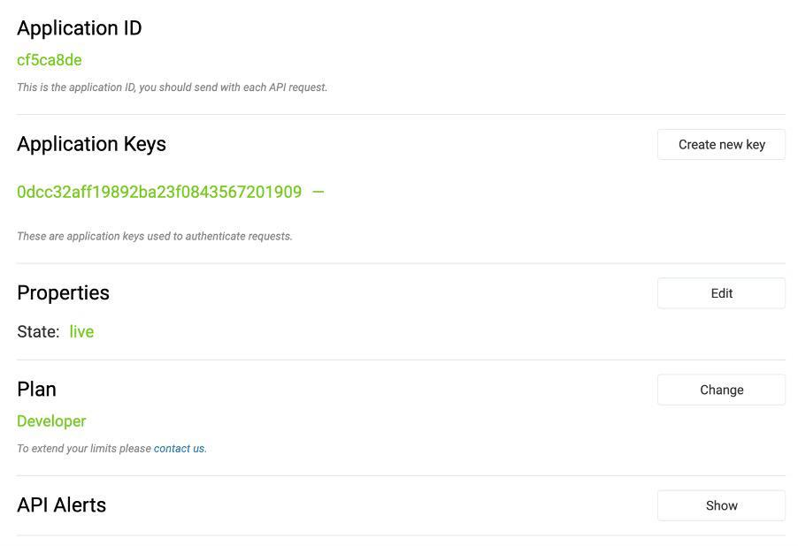
Using the Edamam API
import requests from pprint import pprint

Slide 4
Creating Variable one
ingredient_request = "cheese" application_key = "0dcc32aff19892ba23f0843567201909" application_ID = "cf5ca8de" url = "https://api.edamam.com/search?q={}&app_id={}&app_key={}". format(ingredient_request, application_ID, application_key)

Slide 5
API Response
response = requests.get(url) print(response) ingredient = response.json() pprint(ingredient)

Slide 6
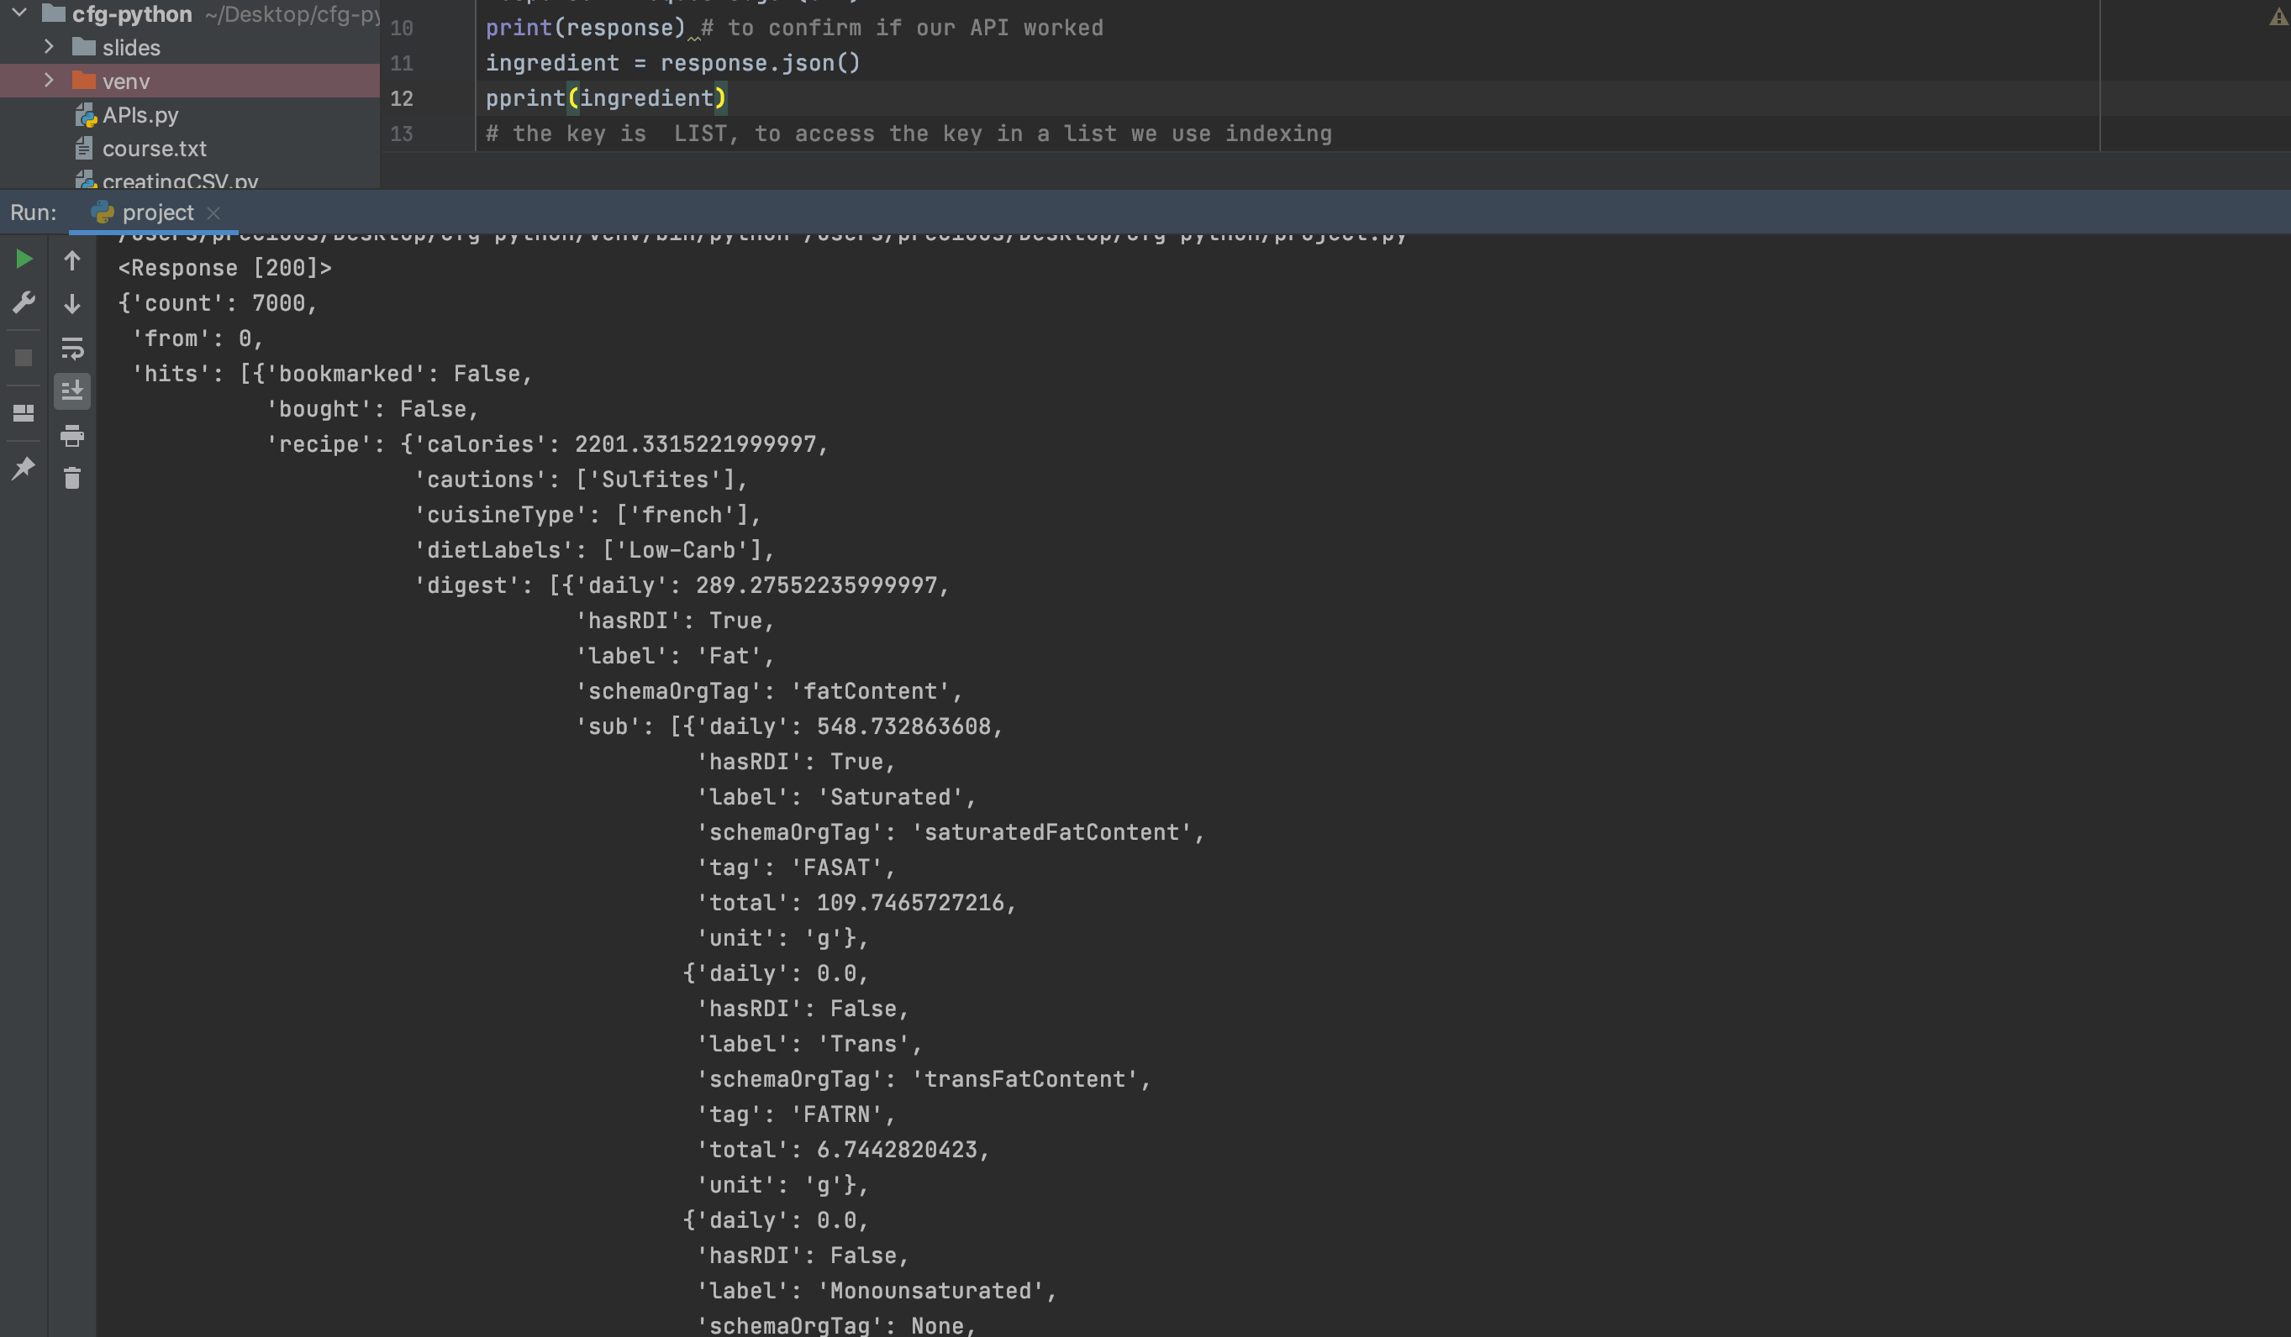
Creating Variable two
def recipe_properties(): recipe_dictionary = ingredient['hits'][0]['recipe'] print("This recipe has {} kcal".format(recipe_dictionary['calories'])) print("This recipe is {} cuisine".format(recipe_dictionary['cuisineType'][0])) pprint(recipe_dictionary['label'][0]) pprint(recipe_dictionary['digest'][0]['label'])recipe_properties()

Slide 7
User Output (Python Console window)
<Response [200]> This recipe has 2201.3315221999997 kcal This recipe is french cuisine ‘S’ ‘Fat’
Process finished with exit code 0

Slide 8
Full Code
import requests from pprint import pprint
ingredient_request = "cheese" #input("Write an ingredient: ") application_key = "0dcc32aff19892ba23f0843567201909" application_ID = "cf5ca8de" url = "https://api.edamam.com/search?q={}&app_id={}&app_key={}".format(ingredient_request, application_ID, application_key)
response = requests.get(url) print(response) # to confirm if our API worked ingredient = response.json() pprint(ingredient) # the key is LIST, to access the key in a list we use indexing
def recipe_properties(): recipe_dictionary = ingredient['hits'][0]['recipe'] pprint(recipe_dictionary['calories']) pprint(recipe_dictionary['cuisineType'][0]) pprint(recipe_dictionary['label'][0]) pprint(ingredient['recipe']['digest']['label'][0]) #listt = ["ch","dam","cfg"] recipe_properties()

Slide 9
Thank you for listening

